Slide 1
Fake Job Postings Detection
Project 4
Group 2
Derek Bates
Brynn Butler
Ally Eveslage
Jackson Popelka
Erica Wollmering
Notes:
ERICA
Hi everyone. For our project, we decided to explore the growing issue of fake job postings — listings that appear legitimate but are actually scams designed to steal time, money, or even personal data from job seekers.
As a group, we were curious whether machine learning could help identify patterns in these deceptive listings. So we trained a classification model using real job posting data from 2016, and then tested its performance on more recent data from 2023 and 2024 to see how well it held up over time.
In this presentation, we’ll walk you through the problem, our data sources, how we built and evaluated our model, and what insights we gained from the results.

Slide 2






Background
Cleaning
ML Approach
Visual Insights
Limitations
Next Steps
Notes:
ERICA
Here’s a quick look at how we structured our project.
We started with the background — identifying why fake job postings matter and how they impact real people.
Then we moved into data cleaning, where we prepared and preprocessed the dataset to ensure the model could work effectively — especially important since we’re working with an imbalanced dataset.
Next was our machine learning approach — where we built and trained our model using the 2016 dataset, and tuned it for better performance.
From there, we dug into visual insights, pulling out patterns like which words, titles, and regions were more common in fake postings.
After evaluating our results, we took time to acknowledge some of the limitations — including the small percentage of fake listings and potential shifts in scam behavior over time.
And finally, we’ll close with next steps, where we’ll talk about how this project could evolve into a real-world application — or how the model might improve with additional data and retraining.

Slide 3
Background
Notes:
ERICA

Slide 4

Problem
Fake job listings can waste applicants’ time, expose them to financial scams, and even lead to identity theft.
In a job market where people are already vulnerable, these scams exploit hope and urgency — often leaving real harm in their wake.
Why do fake job postings matter?
Notes:
ERICA
So why do fake job postings matter?
Well, beyond just being annoying or misleading, they can have serious consequences. Many of these scams ask applicants for sensitive personal data, like Social Security numbers or banking information, under the guise of a background check or direct deposit setup.
Others go further — asking people to pay upfront for equipment, training, or certifications that never materialize.
These scams cost people time, money, and sometimes even put them at risk of identity theft — all while they’re just trying to find work.
That’s what drew us to this problem. We wanted to see if we could train a machine learning model to help flag these fake listings before someone falls into the trap.

Slide 5
The Data
2016 Data
2023-2024 Data
Contains ~18,000 job postings
Each listing is labeled as “real” or fraudulent”
Kaggle does not provide documentation on how these labels were created
Contains recent job postings scraped from LinkedIn
Does not include labels for “fake” vs. real postings
Used to test model performance on more recent job postings
Notes:
BRYNN
To train our machine learning model, we used:
a 2016 dataset from Kaggle that includes about 18,000 job postings, with 866 labeled as fake.
Each posting is labeled as either real or fake, but unfortunately, there’s no documentation provided about how those labels were created.
Because of that, we proceeded with caution and treated the dataset as a training tool — useful for modeling, but not definitive. It still allowed us to build and evaluate our classifier based on a known label column.
For testing with more recent data, we used:
a 2023–24 dataset also from Kaggle consisting of recent job postings scraped from LinkedIn. This dataset doesn't have explicit labels for fake postings, making it ideal for evaluating our model's ability to generalize and detect potential fraud in newer, unlabeled data.
By training on the labeled 2016 data and testing on the more recent dataset, we aimed to assess the model's effectiveness in identifying fraudulent job postings over time.

Slide 6

Shared Columns
To align the 2016 and 2023–24 datasets, we focused on shared columns.
Our model used text-based fields — like job title, company profile, description, requirements, and benefits — combined into a single input.
Other fields, like location or salary, were explored for visualization but not used in training.
2 Datasets
Notes:
BRYNN
Both datasets had many overlapping columns, which made them easier to work with.
For model training, we focused on the text content of the listings — using job titles, descriptions, requirements, etc.
Other metadata like location, salary range, or employment type weren’t used as features in this version — but they’re valuable for future exploration or modeling.

Slide 7

Challenges - Only 4.3% of Postings Are Fake
Challenge
Imbalanced Dataset
We can't rely on accuracy alone.
We’ll look at precision, recall, and F1 score.
Notes:
BRYNN
The key challenge for us was the imbalanced dataset.
We couldn’t rely on accuracy alone — a model could guess “real” every time and still be 95% accurate. If a model is 95% accurate, is it good? ...Well, what if it misses all the fraud?
That’s why we’ll look at precision (of the ones the model said were fake, how many actually were?), recall (of the actual fake ones, how many did the model find?), and F1 score (the balance between precision and recall) later in the presentation.

Slide 8
Cleaning the Data
Notes:
BRYNN

Slide 9
Preprocessing for Better Results
2016 Data
Loaded and duplicated raw CSV for safe editing
Checked value counts and flagged low-variance columns
Selected relevant features (e.g. title, description, location, education, experience)
Split location column into country, region, and city
Renamed columns for clarity and consistency
Exported cleaned data to new CSV for modeling
Notes:
BRYNN
To prepare the 2016 dataset for machine learning, we completed several preprocessing steps to clean and standardize the data:
Read in the raw CSV and created a working copy for safe editing.
Checked value counts to identify columns with limited diversity or excessive missing values.
Filtered down to relevant columns, including key features like job title, employment type, education level, and company profile.
Split the location column into separate fields — country, region, and city — for easier geographic analysis and modeling.
Renamed columns for clarity and consistent reference throughout our workflow.
Finally, we exported a cleaned and reformatted CSV, which we used for model training and feature engineering.
These steps helped us reduce noise, handle missing or inconsistent data, and get everything into a format that our model could work with effectively.

Slide 10
Our ML Approach
Notes:
DEREK

Slide 11

Machine Learning
Combined multiple text fields into a single input
Used TF-IDF vectorization to convert text to numeric format
Trained a Random Forest Classifier using GridSearchCV
Tuned n_estimators and max_depth for best F1 score
approach
Notes:
DEREK
Our machine learning pipeline started by combining several text-based columns, like the job title, description, and requirements, into a single text field.
We then used TF-IDF vectorization, which converts that text into a format the model can work with by emphasizing terms that are distinctive across postings.
From there, we trained a Random Forest Classifier, using GridSearchCV to tune hyperparameters — specifically n_estimators and max_depth.
Our optimization focused on F1 score, since we wanted to balance precision and recall due to the highly imbalanced data.

Slide 12
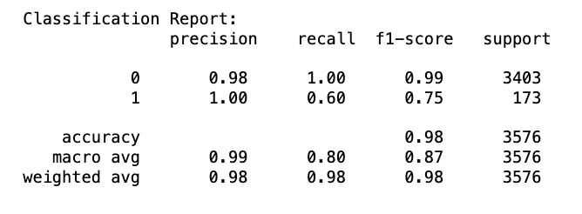
Model Performance & Metrics
Accuracy, Precision, Recall, F1
Accuracy
Notes:
DEREK
Accuracy can be misleading with imbalanced datasets, so we focused more on F1 score, which balances how many fake jobs we catch vs. how often we falsely flag real ones.
The overall weighted F1 score was 0.98, showing strong overall model performance — even with an imbalanced dataset.
For fake job postings specifically, our model achieved an F1 score of 0.75, with 100% precision and 60% recall.
model is extremely good at identifying real jobs
It correctly flags ~60% of fake jobs — solid given the low class count (only 173 fake jobs in test set).
High precision on fakes means very few false alarms.

Slide 13
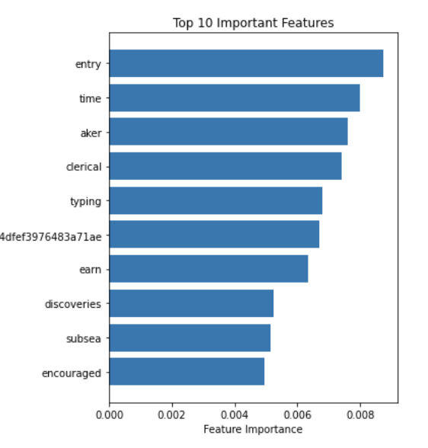
How the Model “Thinks”
Top features included keywords, company descriptions, and location signals
Feature importance chart generated from Random Forest model
Notes:
DEREK
This bar chart shows the top 10 most important words used by our model to classify a job as fake or real.
Some of them are intuitive, like "entry", "clerical", "typing", and "earn" — which often appear in lower-wage, vague, or scam-prone job listings.
Others are more unexpected, like "subsea", "discoveries", or even a hashed token — which may be artifacts of specific fraud clusters in the dataset.
Seeing these words gives us insight into how the model is making decisions, and helps us understand the red flags it's picking up on — a big reason we chose Random Forest: it’s not just performant, it’s explainable.

Slide 14
Insights
Notes:
ALLY

Slide 15

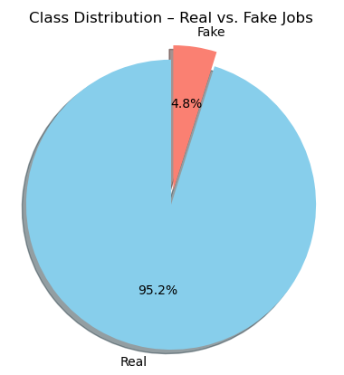
2016
Real vs Fake
Notes:
ALLY
Looking at the provided pie chart, we can see that in 2016, approximately 4.8% of online job listings were fraudulent, while 95.2% were legitimate.
Although 4.8% may seem like a small fraction, it's important to note that these fake listings often targeted high-demand job titles.
As a result, even a small percentage of fake jobs could attract a large number of applicants, increasing the risk for many job seekers.

Slide 16
2016
Job Titles
Real vs Fake
Notes:
ALLY
Bar Charts

Slide 17
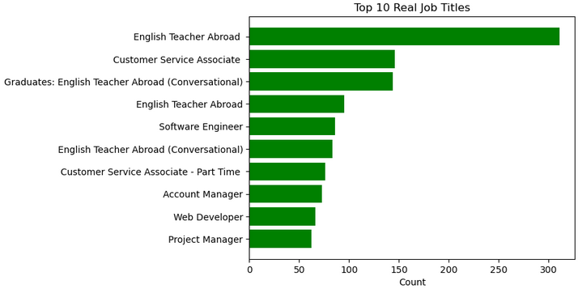
Top 10 Real Jobs Listed
Notes:
ALLY
This bar chart displays the top 10 most frequently listed real job titles, offering insight into genuine employment opportunities.
"English Teacher Abroad" stands out as the most listed role, with nearly 300 postings, indicating strong demand for English educators internationally.
Other prominent positions include “Customer Service Associate,” “Software Engineer,” and “Account Manager”.
English Teacher being a recurring genuine job listing

Slide 18
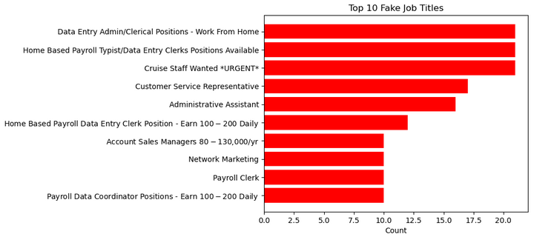
Top 10 Fake Jobs Listed
Notes:
ALLY
This bar chart highlights the top 10 most commonly listed fake job titles.
The most frequently reported fake listings include positions like “Data Entry Admin/Clerical Positions - Work From Home” and “Home Based Payroll Typist/Data Entry Clerks Positions”.
Other deceptive roles include “Cruise Staff”, “Customer Service Representative,” and “Payroll Data Coordinator.”
These scams often target job seekers with remote work offers or high daily earnings.
The chart serves as a cautionary reminder to verify job listings, especially those that sound too good to be true.

Slide 19
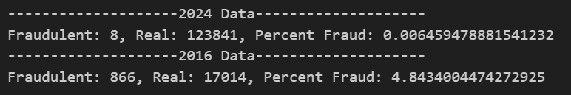
Key Differences Between the Datasets
Notes:
ALLY
The data comparison between 2016 and 2024 reveals a dramatic decline in job fraud.
In 2016, there were 866 fraudulent job listings out of 17,014 real ones, resulting in a fraud rate of approximately 4.84%.
By 2024, only 8 fraudulent jobs were recorded among 123,841 real listings, bringing the fraud rate down to a mere 0.0065%.
This data highlights two key possibilities. First, the sharp decline in fake job postings points to notable advancements in fraud detection and overall platform security. Second, it also raises the possibility that, in today’s increasingly tech-savvy landscape, fraudulent listings may be better disguised—potentially making them harder to detect and more likely to appear legitimate.
the 2024 dataset lacks explicit fraud labels, making it a valuable test case for evaluating how well a machine learning model can generalize and identify fraudulent postings in real-world, unlabeled scenarios.

Slide 20
Limitations
Notes:
JACKSON

Slide 21

Challenges
& Caveats
Outdated training data — scammers evolve fast.
Small proportion of fake listings (~4.3%)
Manual labeling may introduce bias
We're building intuition, not a perfect detector
Warning!
Notes:
JACKSON
One big caveat is that our training data is from 2016, and scams evolve — so the patterns we learned may miss modern techniques.
Also, fake listings are rare — only about 4% of the data — which makes modeling hard and easy to bias toward the majority class.
And even the “fake” labels themselves were determined manually. That can introduce human subjectivity — someone might label a strange-but-real listing as fake.
So rather than aiming for a perfect scam detector, we see this model as a tool to build intuition and explore red flags — not make final decisions.

Slide 22
What’s Next & Final Thoughts
Notes:
JACKSON

Slide 23
Next Steps
Re-train on updated job datasets
Explore more advanced NLP (e.g., BERT)
Integrate as a flagging tool for job platforms ?
Use for scam-awareness education & training?
Real World Use Cases
Notes:
JACKSON
Our first next step would be to retrain the model on newer data, since scam tactics change quickly over time.
We could also explore more advanced natural language processing — for example, using transformer-based models like BERT to better understand context in job descriptions.
This kind of model could be built into job platforms like LinkedIn or Indeed as a behind-the-scenes flagging tool — not to block listings, but to alert reviewers.
Finally, even if the model isn’t perfect, it’s already useful for education — helping job seekers recognize red flags and avoid scams.

